Slide 1
Project meeting (2016-11-21)
-
DVA313

Slide 2
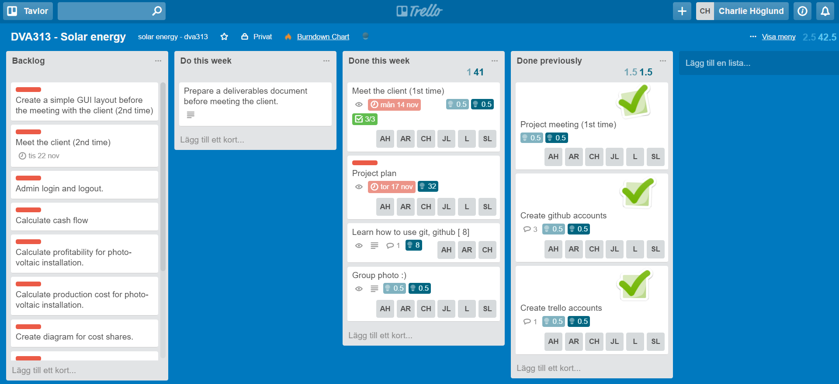
Trello board – Week 46
Outcomes:
Finished the project plan, had a meeting with the client, learnt how to use github, took a group photo
We will continue working with the preparation document (e.g. questions) for the client, since the meeting with the client is tomorrow

Slide 3
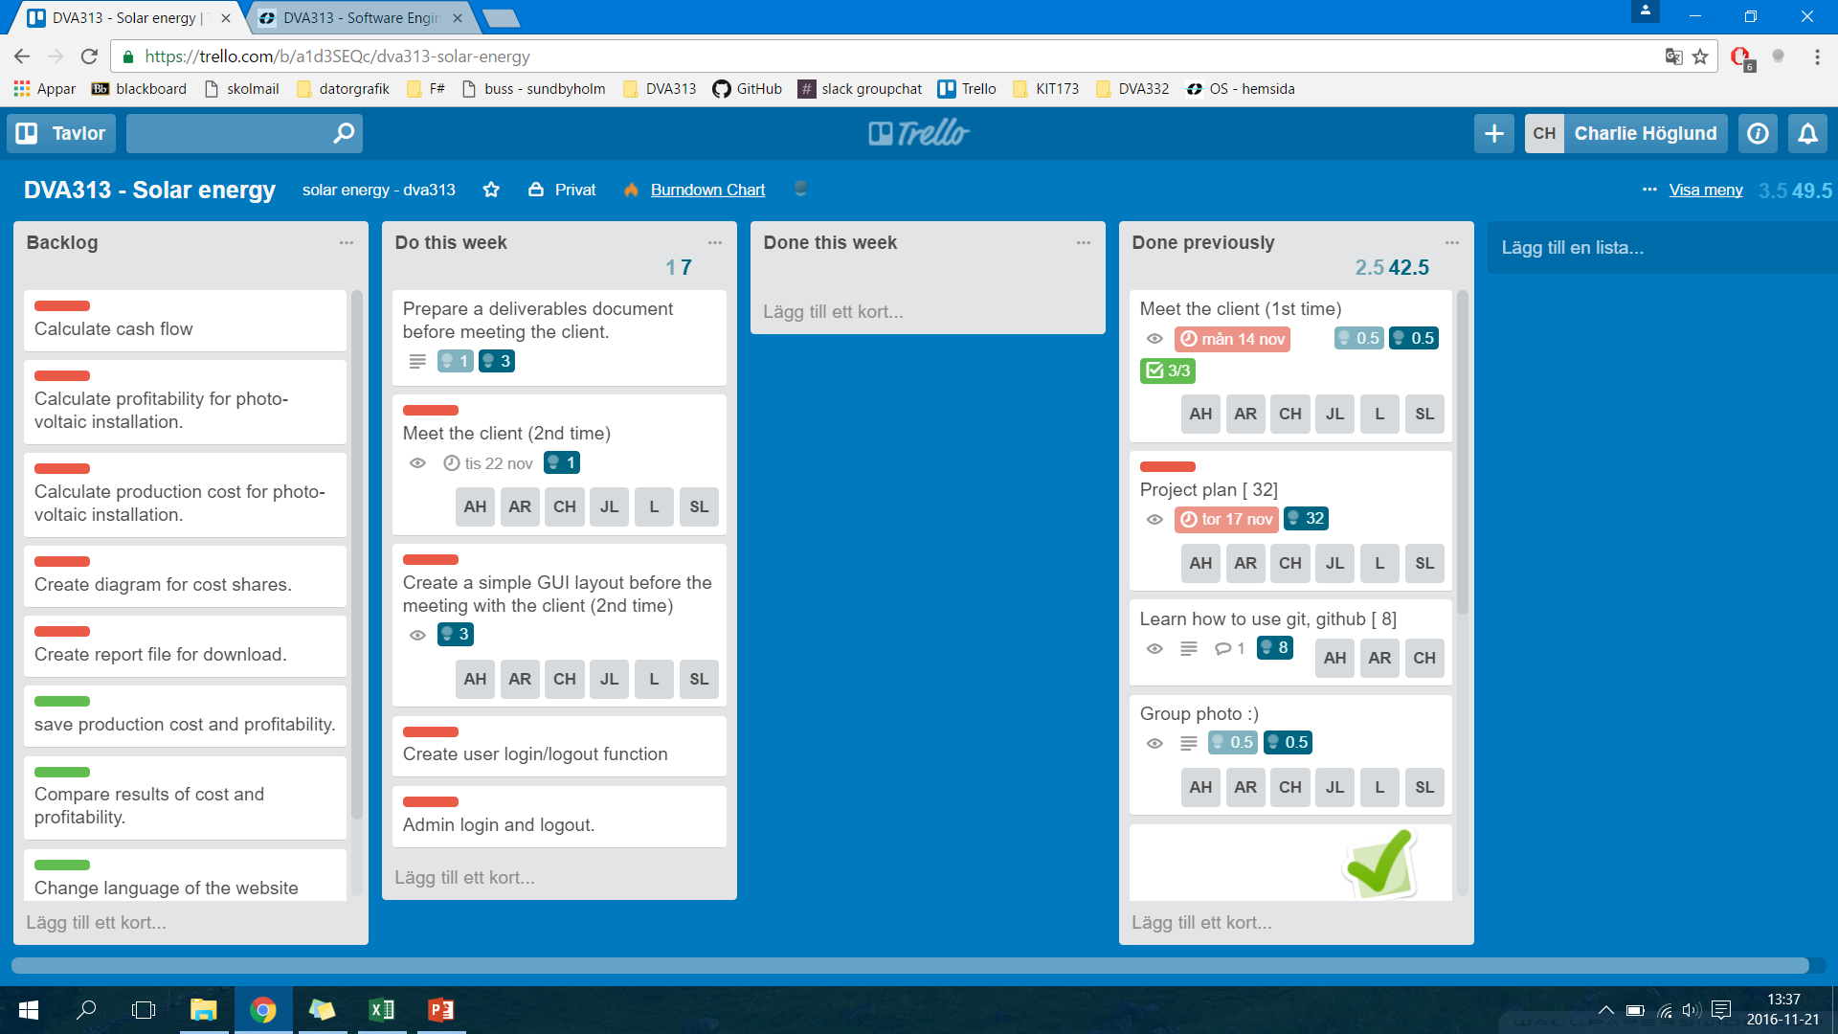
Trello board – Week 47
OBS. This trello board will be changed during this week (i.e. we will assign estimated hours, assign certain project members to some activities…) ADD ”PREPARATION FOR THE PRESENTATION OF THE PROJECT PLAN”…

Slide 4
Any obstacles, risks or issues that have been identified
None at the moment – we will see after the meeting with the client tomorrow.

Slide 5
Worked hours for each member, for each past week and accumulated so far
There is a separate excel file for each project member on the Github repository.

